Slide 1


CONSTRUCTION
Zabbler X
This Car is futuristic.

Slide 2

Human Helping Technology
Artificial intelligence (AI): Enhances diagnostics and treatment
A concrete mixer machine, also known as a cement mixer, is a device that mixes cement, water, and other materials to create concrete. Concrete mixers are used in construction to prepare concrete on-site, saving time and labour. As we know that has some health hazards like dust exposure , skin and eye contact , moving parts , noise , overturning , musculoskeletal injuries etc . We want to recover ourselves from this hazards by using our new product automatic cement mixture Zabbler X007.

Slide 3
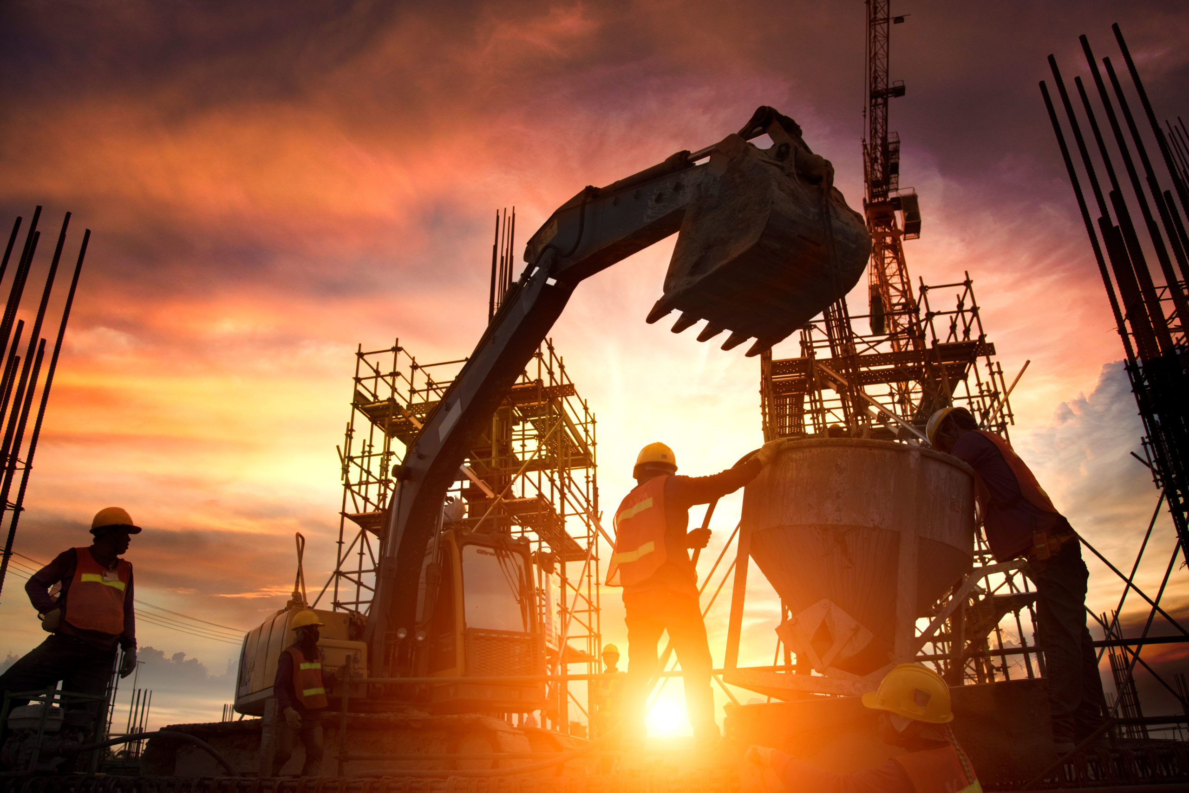
Why we use it ????
It reduces the time
Reduce the labour cost
One time investment and life time service
Government should be notified about the quantities of used product
No uses of fuel and electricity
Using of the ordinary cement mixture is the cause of many type of disease . It should help us to reduce those problem as well as .

Slide 4
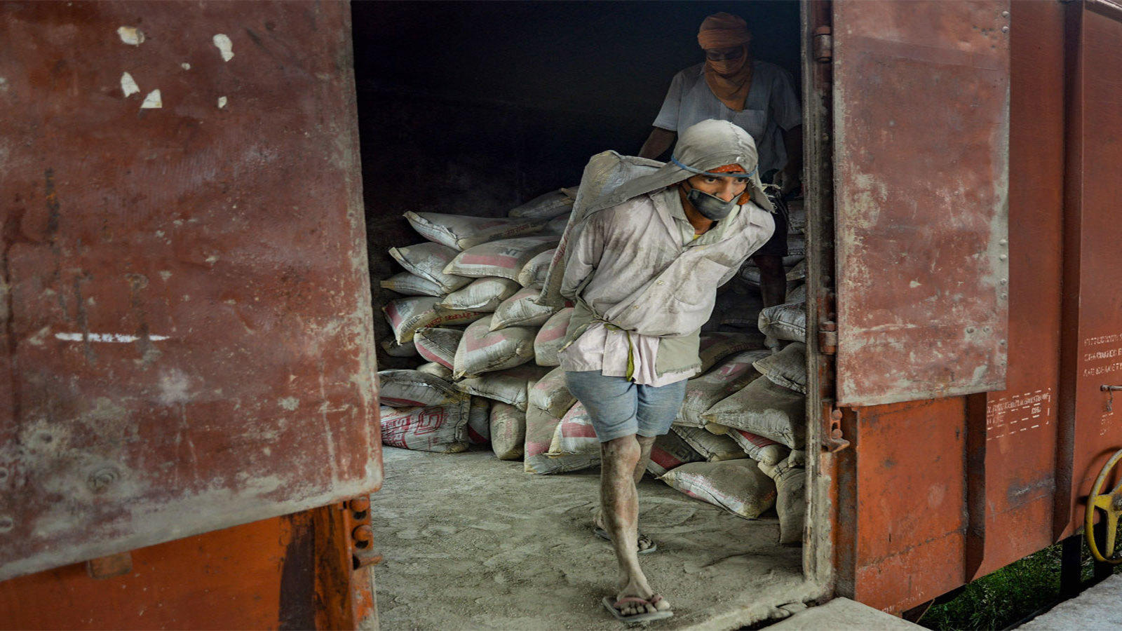
Safety :
The labours more than 60 years age faces many difficulties about health like
Spondylosis
Sunstroke
Physical weakness

Slide 5

SUBWAY STATION
The construction of subway station with involves automating critical tasks to enhance efficiency, precision, and safety during this complex , large -scale infrastructure project, Robots, streamline excavation, structural assembly, finishing , and inspection processes , ensuring the timely completion of these vital urban transit hubs.
WHAT WE ARE WORKING ON
ROAD BRIDGES
A road bridges using robot involves teams equipped with advance robotic systems designed to assist or completely automate the construction, repair , and maintenance of roads.
INDUSTRIAL BUILDING
Constructing an industrial building with robots involves leveraging advanced robotic systems and automation to efficiently complete tasks such as site preparation, structural assembly , and finishing.
THERMAL POWER PLANT
The construction of a thermal power plant with robots involves leveraging advanced robotic system to automate and optimize various phases of the project from site preparation to plan commissioning.

Slide 6

ABOUT THIS PROJECT
CONSTRUCTION PROJECTS USING ROBOTS:
A Modern Approach
Robots are transforming the construction industry by automating various aspects of the process, ensuring enhanced efficiency, precision, safety, and sustainability. Construction projects using robots represent a forward-thinking approach, leveraging advanced technology to tackle complex tasks and optimize workflows.

